Slide 1

Project Management Masterclass Day Six

Slide 2


Project Management Methodologies
“Waterfall” (standard) Project Management
In the standard project management, the Planning is performed before the execution starts. Efforts are invested in detailed planning, where the PM and project team structure all the work to be done (see pic.1). The execution plan consists of sequenced activities, according to their dependency. As a result, on a calendar (on the Gantt chart), the plan resembles a waterfall (see pic.2).
Pic.1:
Pic.2:
Execution
 | Year 2020 January February March April May
Ind Activity |  | 1/6 | 1/13 | 1/20 | 1/27 | 2/3 | 2/10 | 2/17 | 2/24 | 3/2 | 3/9 | 3/16 | 3/23 | 4/20 | 4/27 | 5/4 | 5/11 | 5/18
 |  | 1 | 2 | 3 | 4 | 5 | 6 | 7 | 8 | 9 | 10 | 11 | 12 | 16 | 17 | 18 | 19 | 20
A | Prepare land for construction works
B | Excavate foundations (Digging)
C | Build foundation structure
D | Build Showroom spaces (floor 1)
E | Complete Roof works
Initiation
Planning
Closure
M & C
AGILE Project Management
In the past 20-30 years, project complexity has increased significantly. Internet, new technology, and globalization have changed the business world. Projects and project management have also been impacted inevitably. The project goals and their scope have become much more difficult to describe in advance. Hence, planning with a great level of detail without making multiple changes to this plan is almost impossible. AGILE has been introduced as a new approach to address this challenge. The method suggests planning and executing pieces of the scope and factoring in any changes in between these pieces. They are called “Iterations” and include detailed planning and the respective execution.
Iteration 1 Iteration 2 Iteration 3
Initiation
Overall Planning
PLAN & EXECUTE
PLAN & EXECUTE
PLAN & EXECUTE
…
Closure

Slide 3
Agile Manifesto
We are uncovering better ways of developing software by doing it and helping others do it. Through this work we have come to value:
© 2001, the above authors this declaration may be freely copied in any form,
but only in its entirety through this
notice.
Individuals and interactions over processes and tools Working software over comprehensive documentation Customer collaboration over contract negotiation Responding to change over following a plan
That is, while there is value in the items on the right, we value the items on the left more.
Kent Beck Mike Beedle Arie van Bennekum Alistair Cockburn Ward Cunningham Martin Fowler | James Grenning Jim Highsmith Andrew Hunt Ron Jeffries Jon Kern Brian Marick | Robert C. Martin Steve Mellor Ken Schwaber Jeff Sutherland Dave Thomas

Slide 4


Project Structure
The main phases in Scrum projects are standardized “SPRINTS”
The sprints are of the same duration, usually between one and four weeks
Each sprint has to deliver a specific part of the product backlog
Initiation
Overall
Planning
Sprint 1
D
Sprint 2
D
Sprint 3
D
…
Closure
DEMO
A “Demo” meeting is organized at the end of each sprint. The goal is to
D
show the completed work to the product owner and stakeholders

Slide 5


Defining the Scope
Defining the Scope:
Project Goal
EPIC A EPIC B
User Story
(format)
User Story
A1
User
Story
A2
User
Story
A2
User
Story
B1
User Story
B2
User Story
B2
As a user, I want to be able to …
A1
Features
A2
Features
…
B1
Features
B2
Features
Product BACKLOG

Slide 6
SCRUM: Concepts
Defining the Scope:
The scope is structured from high to low level in the following way:
As always, you start from the Project Goal definition: E.g. As an extension to the existing financial services of the company – “Create a mobile payment application”
Project Goal
Then, you proceed with the high-level requirements. They are called EPICs:
EPIC example: “Creation of an electronic wallet”; “Deposit funds to e-wallet”; “Transfer
funds to recipients”;
EPIC A EPIC B
EPICS are still high-level so we move down to the details by defining “User Stories”. They are detailed descriptions of what the customer or user of the product wants to be able to do. Their main goal is to translate the user expectations, desires, and wishes into separate easy-to- understand requirements or “stories”.
User Story
A1
User Story
A2
User Story
A2
User Story
B1
User Story
B2
User Story example: “As a user, I want to create a wallet via registering through e-mail”;
“As a user, I want to be able to top-up my wallet by using a bank account”;
The User Stories finally give the needed granularity. However, one more step is needed for the developers – the User Stories need to be translated into technical tasks. They are called “Features”:
User Story | Feature
I want to create wallet via registering through e-mail; | Implement a registration wizard for first-time users Implement Secure Log-in using Username and Password Implement Log-out
I want to be able to upload a profile picture | Implement a dialogue to upload a profile picture (. jpeg; .png;)
A1
Features
A2
Features
…
B1
Features
Note: 1 user story may correspond to one or more Features
Product BACKLOG
Finally, all Features and User Stories are collected in a list. This list is the backbone of the project Scope and is called “Product Backlog”

Slide 7
Defining the Scope: Example
Create a mobile payment application
Deposit funds to e-wallet Transfer funds to recipients
I want to create a wallet via registering through e-mail
I want to be able to top-up my wallet by using a bank account
I want to be able to upload a profile picture
User Story
B1
User Story
B2
User Story
B2
As a user, I want to be able to …
Implement registration wizard
Implement secure log-in using username and password
Implement an integration to a Bank API
Implement a dialogue to upload a profile picture (. jpeg;
.png;)
B1
Features
B2
Features
Product BACKLOG

Slide 8



Roles and responsibilities
Development (or delivery) team
Development team responsibilities:
Scrum Master responsibilities:
Perform work as per backlog priority
Deliver ready to use product each Sprint
Work with customer to translate user stories into features
Develop software features according to priority
Resolve technical issues and test solutions
Leads the Scrum team
Guides the Product Owner in defining the backlog priorities
Works to ensure the Sprint commitments are met
Works to remove roadblocks for the development team
Facilitates Daily Stand-Up meetings (DSUs)
Facilitates Demo Sessions
Facilitates backlog grooming and Retrospective sessions
Scrum Master
Product Owner responsibilities:
Is or represents the product's customer or user
Defines the backlog
Reviews and accepts the completed backlog
Prioritizes the backlog for each Sprint
Approves/requests changes to the backlog priority
Product Owner

Slide 9
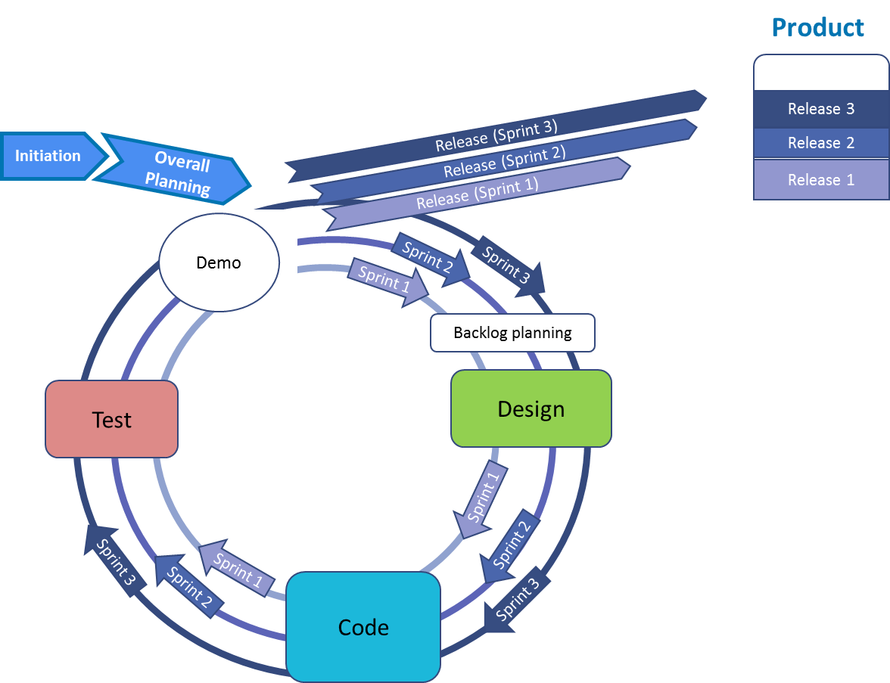
SCRUM: Project Overview (e.g. Software development)
The standard phases of software development include designing the solution, coding, and finally, testing the software. The original way of structuring such similar work included performing these steps only once (designing the whole work, coding the whole program, and then testing the entire software created).
This has been leading very often to heavy reworks and multiple changes in a single project.
Start Design Code Test End
The lifecycle of a Scrum project suggests, on the other hand, to work step by step – designing, coding, and testing one part, before moving to the next one:
Overall Planning (Sprint 0)
Sprint 1:
Backlog planning
Execute work
Demo
Release of the completed product
Sprint 2:
Backlog planning
Execute
Demo
Release of the completed product
Sprint 3 (…)
In order to ensure the work meets expectations and needs, the Product Owner has to play a very active role. The PO has to always attend the planning and demo sessions of each Sprint.
92

Slide 10

Conclusion
In conclusion, we learned that successful software development requires efficient project management, careful planning, and continuous monitoring throughout the development life cycle. With the right project management techniques, software development teams can achieve their objectives while meeting the project's requirements, budget, and timeline.

Slide 11


Turn challenges into opportunities.
Ask more.
QA Session

Slide 12

Anmol, Offline
See you tomorrow.

Slide 13
https://bit.ly/leaf-nepal-dm01-sub
REVIEW AND NOTE SUBMISSION

